Slide 1
Preparing Mathematicians for Big Data Careers An Insider’s Perspective
Paul Raff
Principal Data Scientist, Microsoft
Presentation to the <>
January 7, 2016

Slide 2




About Me
 | 2004 – BS Mathematics, BS Computer Science
 | 2009 – PhD Mathematics
 | 2010 – Applied Researcher, Supply Chain Research
 | 2012 – Principal Data Scientist, Analysis and Experimentation

Slide 3

Our Team
Microsoft’s Analysis and Experimentation Team
Accelerating innovation via trustworthy analysis and experimentation
http://www.exp-platform.com

Slide 4
Our Experience Hiring Data Scientists
I’ve been in charge of recruiting for the past 2 years, so I have been in contact with most/all of our candidates in the process.
500 | Applications considered
250 | First phone screens
120 | Second phone screens
60 | Onsite interviews
20 | Offers for employment given

Slide 5
The Questions We Address
What does it take for a mathematics or a statistics major to both find a data science job and succeed in a data science career?
What steps can faculty and educators take to facilitate this process?

Slide 6
The Data Science Venn Diagram
Understanding the Data Science Venn Diagram can help faculty better prepare their students for careers in data science.
Let’s go through the venn diagram piece by piece and discuss how this can shape and inform.
Computer Science
Skills
Mathematics/
Statistics
Knowledge
Machine
Learning
Scientist
Data
Scientist
Danger
Zone!
Traditional
Researcher
Substantive Expertise
Domain Knowledge
Thanks to Drew Conway

Slide 7
The Data Science Venn Diagram
Here’s your primary sphere of influence as educators.
Computer Science
Skills
Mathematics/
Statistics
Knowledge
Machine
Learning
Scientist
Data
Scientist
Danger
Zone!
Traditional
Researcher
Substantive Expertise
Domain Knowledge
Thanks to Drew Conway

Slide 8
The Data Science Venn Diagram
Here’s your primary sphere of influence as educators.
Great work! There’s no risk of being in the Danger Zone as long as the math/stats fundamentals are retained.
Computer Science
Skills
Mathematics/
Statistics
Knowledge
Machine
Learning
Scientist
Data
Scientist
Danger
Zone!
Traditional
Researcher
Substantive Expertise
Domain Knowledge
Thanks to Drew Conway

Slide 9
The Data Science Venn Diagram
Now, let’s focus on these two portions of the venn diagram.
They are equally-sized, and that is appropriate.
Computer Science
Skills
Mathematics/
Statistics
Knowledge
Machine
Learning
Scientist
Data
Scientist
Danger
Zone!
Traditional
Researcher
Substantive Expertise
Domain Knowledge
Thanks to Drew Conway

Slide 10
The Data Science Venn Diagram
Now, let’s focus on these two portions of the venn diagram.
They are equally-sized, and that is appropriate.
Strive to continuously incorporate computer programming more and more into your math/stats curriculum.
Computer Science
Skills
Mathematics/
Statistics
Knowledge
Machine
Learning
Scientist
Data
Scientist
Danger
Zone!
Traditional
Researcher
Substantive Expertise
Domain Knowledge
Thanks to Drew Conway

Slide 11

Example 1 – Solving Empirically
Particularly in initial probability courses, most problems have a path to an empirically-found solution via computer programming means.
Ant-on-a-square problem:

Slide 12
Example 1 – Solving Empirically
Particularly in initial probability courses, most problems have a path to an empirically-found solution via computer programming means.
Ant-on-a-square problem:

Slide 13
Example 1 – Solving Empirically
Particularly in initial probability courses, most problems have a path to an empirically-found solution via computer programming means.
Ant-on-a-square problem:

Slide 14
Example 1 – Solving Empirically
Particularly in initial probability courses, most problems have a path to an empirically-found solution via computer programming means.
Ant-on-a-square problem:

Slide 15
Example 1 – Solving Empirically
Particularly in initial probability courses, most problems have a path to an empirically-found solution via computer programming means.
Ant-on-a-square problem:

Slide 16
Example 1 – Solving Empirically
Simulate!
Any language you want, but concisely in R:
trials <- 2*(rnbinom(10000, 1, 0.5)+1)
Leads naturally to the conversation of uncertainty

Slide 17
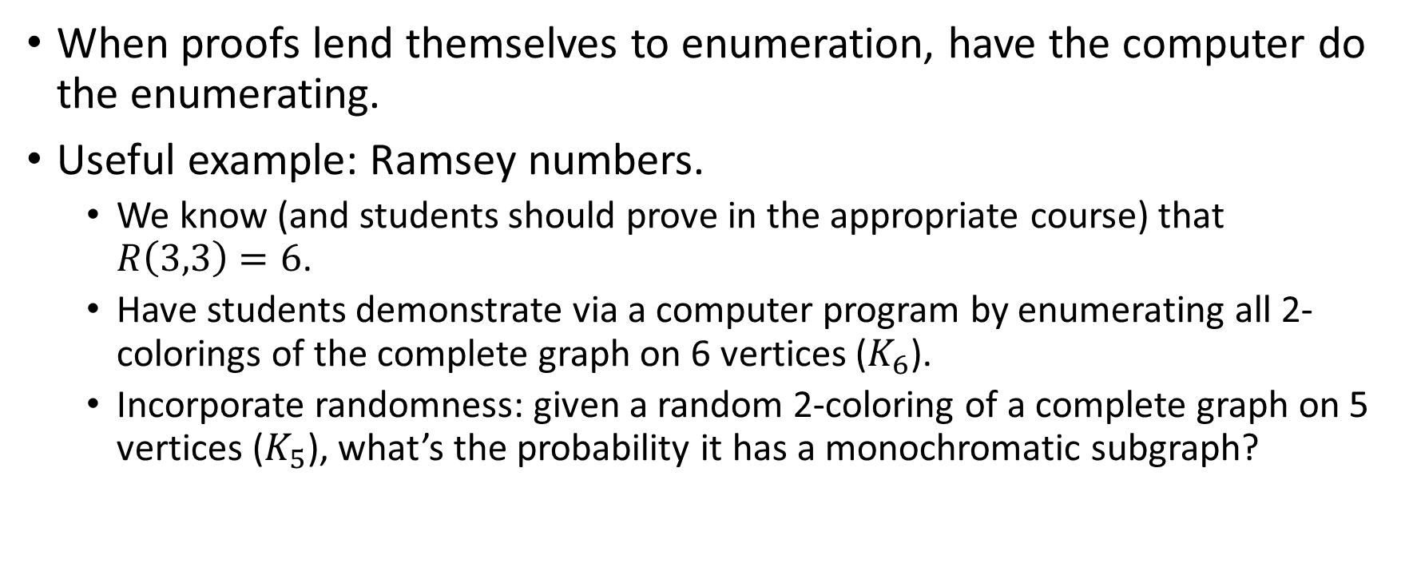
Example 2 – Learning via Brute Force
When proofs lend themselves to enumeration, have the computer do the enumerating.
Useful example: Ramsey numbers.
We know (and students should prove in the appropriate course) that $R\left(3,3\right)=6$.
Have students demonstrate via a computer program by enumerating all 2-colorings of the complete graph on 6 vertices ($K_{6}$).
Incorporate randomness: given a random 2-coloring of a complete graph on 5 vertices ($K_{5}$), what’s the probability it has a monochromatic subgraph?

Slide 18
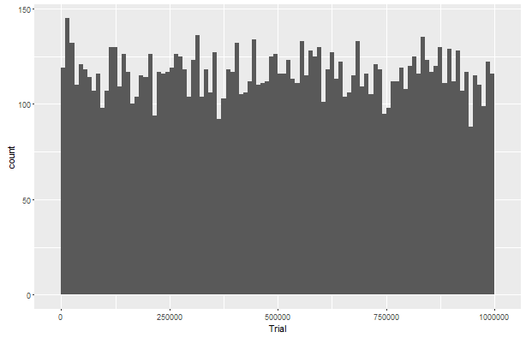
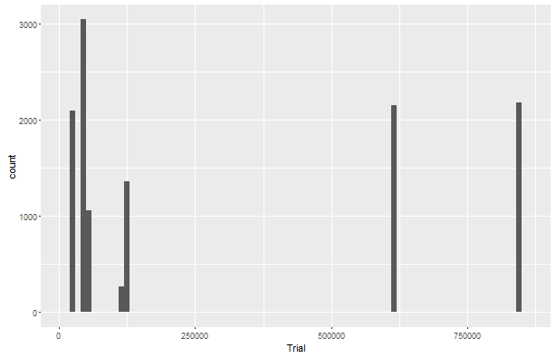
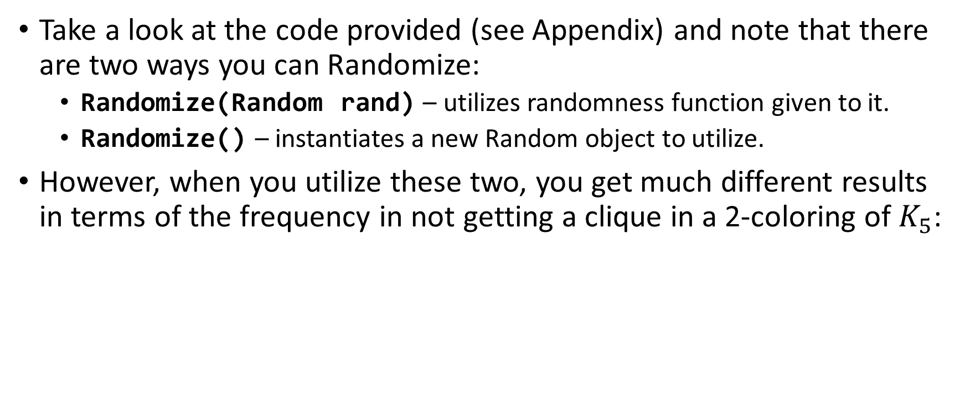
Example 2 – Learning via Brute Force
Take a look at the code provided (see Appendix) and note that there are two ways you can Randomize:
Randomize(Random rand) – utilizes randomness function given to it.
Randomize() – instantiates a new Random object to utilize.
However, when you utilize these two, you get much different results in terms of the frequency in not getting a clique in a 2-coloring of $K_{5}$:
Using common random function throughout
Using new random function each call

Slide 19
Example 2 – Learning via Brute Force What’s Going On?
This is now a data science exercise!
The good data scientist can not only identify which of the two scenariois abnormal against expectation, but can also explain why the observed phenomenon is occurring.
Hint

Slide 20
The Data Science Venn Diagram
This will likely be the greatest challenge to affect as an educator.
Nothing comes close to actual on-the-job experience.
Emphasize internships over traditional summer research opportunities.
Computer Science
Skills
Mathematics/
Statistics
Knowledge
Machine
Learning
Scientist
Data
Scientist
Danger
Zone!
Traditional
Researcher
Substantive Expertise
Domain Knowledge
Thanks to Drew Conway

Slide 21
The Data Science Venn Diagram
Additionally, graduate school is in some senses a mandatory pre-requisite for data science careers.
Computer Science
Skills
Mathematics/
Statistics
Knowledge
Machine
Learning
Scientist
Data
Scientist
Danger
Zone!
Traditional
Researcher
Substantive Expertise
Domain Knowledge
Thanks to Drew Conway

Slide 22
The Biggest Challenge
There are three great career opportunities here – which one is the best for any particular student?
Always a difficult question, but there are two specific situations you should be cognizant of.
Computer Science
Skills
Mathematics/
Statistics
Knowledge
Machine
Learning
Scientist
Data
Scientist
Danger
Zone!
Traditional
Researcher
Substantive Expertise
Domain Knowledge
Thanks to Drew Conway

Slide 23
The Biggest Challenge
The I’m looking for a data scientist but I actually want a software developer situation.
Computer Science
Skills
Mathematics/
Statistics
Knowledge
Machine
Learning
Scientist
Data
Scientist
Danger
Zone!
Traditional
Researcher
Substantive Expertise
Domain Knowledge
Thanks to Drew Conway

Slide 24
The Biggest Challenge
The I’m looking for a data scientist but I actually want a software developer situation.
This is primarily seen in teams that are firmly software development-focused looking for one data scientist to join their ranks.
Computer Science
Skills
Mathematics/
Statistics
Knowledge
Machine
Learning
Scientist
Data
Scientist
Danger
Zone!
Traditional
Researcher
Substantive Expertise
Domain Knowledge
Thanks to Drew Conway

Slide 25
The Biggest Challenge
The data scientist v. machine learning scientist situation.
It’s well-expressed in the venn diagram; data scientists are firmly focused on the business needs.
Computer Science
Skills
Mathematics/
Statistics
Knowledge
Machine
Learning
Scientist
Data
Scientist
Danger
Zone!
Traditional
Researcher
Substantive Expertise
Domain Knowledge
Thanks to Drew Conway

Slide 26
Summary

Slide 27
Digression – Geeking out on Rand()
A naïve implementation of this situation would use Rand() inside the randomize function, which results in very interesting behavior.

Slide 28
The Data Science Venn Diagram
Also, note what’s not available when you are lacking mathematics and statistics knowledge. This is important. When a student is choosing between a computer science major and a mathematics major, then that student should choose mathematics.
Computer Science
Skills
Mathematics/
Statistics
Knowledge
Machine
Learning
Scientist
Data
Scientist
Danger
Zone!
Traditional
Researcher
Substantive Expertise
Domain Knowledge
Thanks to Drew Conway

Slide 29
The Data Science Venn Diagram
Understanding the Data Science Venn Diagram can help faculty better prepare their students for careers in data science.
Computer Science
Skills
Mathematics/
Statistics
Knowledge
Machine
Learning
Scientist
Data
Scientist
Danger
Zone!
Traditional
Researcher
Substantive Expertise
Domain Knowledge
Thanks to Drew Conway

Slide 30
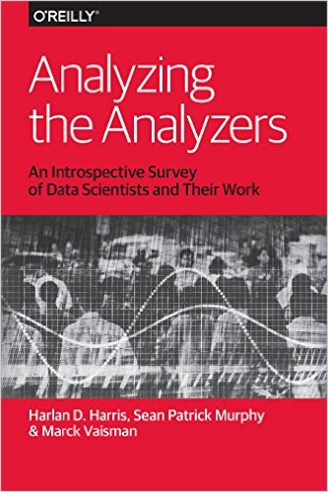
Resources
Analyzing the Analyzers
Useful summary of the different types of data scientists that exist.
Data Businesspeople
Data Creatives
Data Developers
Data Researchers

Slide 31
Appendix

